Slide 1
Week 13
Intro to NoSQL

Slide 2
NoSQL
NoSQL stands for "not only SQL"
A NoSQL database is a database that stores data in a non-tabular format
NoSQL databases handle unstructured, semi-structured, or structured data
Unlike relational databases (SQL), NoSQL dbs provide a variety of data models that suit different types of applications
NoSQL databases are flexible, easy to develop, and horizontally scalable
They are often used for applications that require high availability, reliability, large scale, and frequent data changes
Some NoSQL databases will use the SQL programming language
Some will use alternative query languages to interact with their data
And some will use APIs to interact with their data

Slide 3
Types of NoSQL Databases
Type | Uses SQL/SQL-Like | Uses Other Query Language | No Query Language
Key-Value Stores | DynamoDB (PartiQL) | Redis, Riak | Memcached, LevelDB, RocksDB
Document Stores | BigQuery, CosmosDB | MongoDB (MQL), CouchDB, RavenDB | X
Column-Family Stores | Cassandra (CQL) | HBase | X
Graph Databases | OrientDB, ArangoDB (AQL) | Neo4j (Cypher) | Titan
Time-Series Databases | X | Prometheus (PromQL), InfluxQL | InfluxDB (older versions)
Relational Databases | MySQL, SQL Server | X | X

Slide 4
Types of NoSQL Databases
Key-Value Stores¹
Stores data as key-value pairs
The key is a unique string and the value is an arbitrary data field
A value can be stored as an integer, a string, JSON, or an array
Key-value stores have no query language but provide ways to add/remove
Typically the vendor, like AWS (Amazon Web Services), provides tools to access/insert data
Just a straightforward option for data storage
key
:
value
"phone"
:
"(416) 675-3111"
"binary"
:
1000111010101
"address"
:
{ street: "Finch", city: "Etobicoke" }
¹ Redis: What is a Key-Value Database?

Slide 5
Types of NoSQL Databases
When to use a Key-Value Database¹
Handling Large Volume of Small and Continuous Reads and Writes
Suitable when handling a large volume of small and continuous reads and writes
Storing Basic Information
caching frequently accessed data in a key-value store, allows for faster data retrieval, leading to improved application performance and responsiveness
Applications with Infrequent Updates and Simple Queries
Good to prioritize simplicity and high-performance data access, achieving quick lookups and modifications without complex queries or extensive manipulation (like Relational DBs)
Key-Value Databases for Volatile Data
Volatile Data is temporary, typically stored in RAM
Good for apps that need fast data retrieval, like when training AI models
¹ Redis: What is a Key-Value Database?

Slide 6
Types of NoSQL Databases
Use cases for Key-Value Databases¹
Session Management on a Large Scale
Good for managing session data in applications that require handling a large number of concurrent users like…
Managing Player Sessions in Massive Multiplayer Online Games
Massive Multiplayer Online Games (MMOGs) require real-time management of a large number of simultaneous player sessions, quick data interactions are very useful for this
Using Cache to Accelerate Application Responses
Caching frequently accessed data in a key-value store, allows for faster data retrieval, leading to improved application performance and responsiveness
Storing Personal Data on Specific Users
Can be used to store user profile information, user preferences, or other user-specific data
The simple key-value model allow for quick and efficient access to large volumes of user data
Product Recommendations and Personalized Lists
That user data can be used to personalize product recommendations and lists quickly
¹ Redis: What is a Key-Value Database?

Slide 7
Types of NoSQL Databases
Document Stores¹²
Designed for storing, retrieving, and managing document-oriented information
also known as semi-structured data
These are also considered Key-Value stores but have some differences
Documents in a document store are roughly equivalent to an object
For example this is a document encoded in JSON:
{
"firstName": "John",
"lastName": "Doe",
"address": {
"type": "Home",
"street1":"40 Bay St.",
"city": "Etobicoke",
"province": "ON"
},
"hobby": "hockey",
"phone": {
"type": "Cell",
"number": "(555)-123-4567"
}
}
A traditional Key-Value store only allows querying of the key to get the entire value
Document stores allow for sub-querying of the document
Allowing for more refined CRUD functionality
Ex: search(_source: ["address.province"]);
¹ What is a Document Database?
² Wikipedia: Document-oriented database

Slide 8
Types of NoSQL Databases
Column-Family Stores¹²
Organizes data in columns instead of rows, grouped into column families
Column-Family databases are great for data analytics as scan fewer rows and process less data than row-oriented databases
Meaning they are best when needing to access only data in single columns
On the flip side they are generally not optimized for frequent single-row updates or deletes, or searching for all the data across multiple columns
Column-Family databases support SQL
¹ What are columnar databases?
² Row-Storage vs. Column-Storage

Slide 9
Types of NoSQL Databases
Key Features of Column-Family Stores
Uses Column Families, they are essentially a container for multiple columns
Example: A user_profile column family may include columns name, email, age, and address.
These are considered dynamic columns because a row can have different columns used within the same column family
Useful for storing sparse data, where some fields are irrelevant for certain rows
A single row can store thousands or millions of columns (Wide Rows)
Making column families ideal for time-series data or other cases where data grows horizontally
While this looks like a relational table it stores the data internally as a column family, optimized for distributed reads and writes of columns.
key | name | email | age | address
user_1 | Alice | alice@example.com | 30 | 123 Main St
user_2 | Bob | bob@example.com | 25 | NULL
user_3 | Charlie | NULL | 35 | 456 Elm St

Slide 10
Types of NoSQL Databases
Strengths of Column-Family Stores
High Scalability
Ideal for applications that need to scale horizontally across distributed nodes
Efficient Reads and Writes
Queries focus on specific columns within a column family, reducing unnecessary I/O
Flexible Data Model
Supports sparse data without wasting storage for null values
Fault Tolerance
Designed to operate reliably in distributed environments with replication

Slide 11
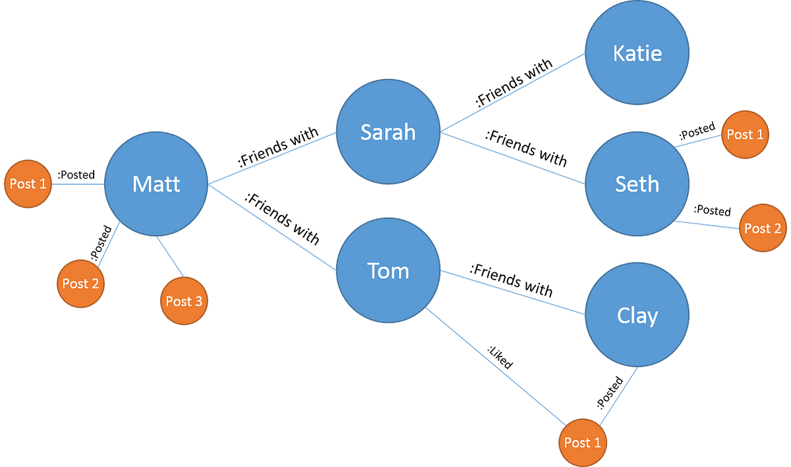
Types of NoSQL Databases
Graph Databases¹ ²
Graph databases use graph structures for storing data
Accomplished by transferring the data into nodes and relationships into edges
¹ What is A Graph Database? A Beginner's Guide
² What is Graph Database – Introduction

Slide 12
Types of NoSQL Databases
Key Features of Graph Databases
Efficient Traversals
Optimized for queries involving relationships
Query performance remains fast even as data grows
Explicit Relationships
Relationships are stored directly which avoids costly JOIN operations on large datasets, like with relational databases
Schema-less / Schema-optional
Nodes and relationships can have any number of properties
Their types or attributes do not need to be defined in advance
Schema-less design allows for easy adaptation to changes in data structure, providing flexibility to the nodes
Visual Representation
Graphs naturally represent data visually, making them intuitive for certain applications
person
person
Friends with
name: “Matt”
phone: “555-123-1234”
name: “Jane”
phone: “555-987-9876”
name: “Jane@gmail.com”
¹ Redis: What is a Key-Value Database?

Slide 13
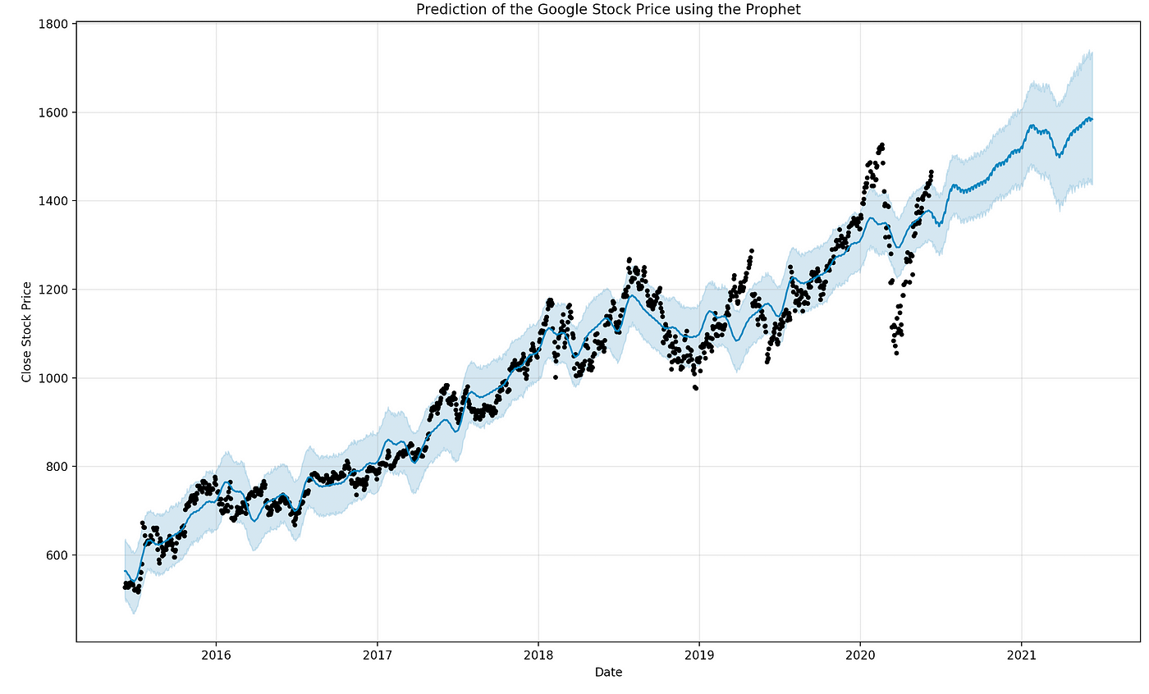
Types of NoSQL Databases
Time-Series Databases¹
A database designed to store/retrieve data that are part of a “time series”
Basically a set of data points that are associated with timestamps
The timestamps provide critical context of how the data points are related
The DBs work by capturing a set of fixed values along with a set of dynamic values
For example, the stock market:
The ticker is the fixed value
The stock price is the dynamic value
Using the behaviour of the data over time we can make predictions about the data moving forward
¹ Time-Series Database: An Explainer

Slide 14
Types of NoSQL Databases
Key Features of Time-Series Databases
Time is fundamental, every data point is associated with a timestamp
High write throughput as these DBs gather data constantly and quickly
They are built to optimize for large volumes of sequential writes
Provide efficient queries on time range, especially compared to traditional relational databases
Data retention and compression is key since time-series data grows quickly
Can use data retention policies to automatically downsample or aggregate older data
For example: After 1 year, the stock prices may only save the closing price of a stock instead of the price at each second of the day
Use Cases
Monitoring & observing software, financial data, tracking renewable energy production, utility metering (water, gas, electricity), environmental monitoring, patient monitoring in hospitals, and other similar cases where time is an important factor

Slide 15
NoSQL Traditional Relational DBs
Flexible data models
Can be schema-less/optional for dynamic data storage
Horizontal scalability
Query languages vary by DB type
Used for applications needing high scalability and flexibility
Optimized for specific access patterns
Structured data organized in tables
Fixed schema with predefined relationships
Vertical scalability
Uses only SQL
Used for applications needing complex relationships/transactions
Performance can degrade with extremely large datasets

Slide 16
NoSQL vs Traditional Relational DBs
Scenario | Relational | NoSQL
Strong relationships | Yes | No (or limited support).
Complex queries (joins) | Yes | Limited or not optimized for joins.
Flexible, evolving schema | No | Yes.
High scalability (horizontal) | No (complex to implement). | Yes.
Large, unstructured datasets | No | Yes.
Real-time analytics | Limited | Yes (optimized for such use cases).

Slide 17
NoSQL
NoSQL Database is a catch all for non relational databases
It encompasses many different types of data structures
Key-Value Stores
Document Stores
Column-Family Stores
Graph Databases
Time-Series Databases
Therefore if you ever need to work a NoSQL database be sure to ask:
What type of NoSQL database?
What technology stack (language, libraries, cloud service) will be used to interact with the database?
How is the database being hosted?

Slide 18
MongoDB
MongoDB is a document-store NoSQL database, it stores data as JSON-like documents
MongoDB can be hosted locally on your machine or more commonly it is hosted on a cloud service like AWS, GCP, or Microsoft Azure
AWS - Amazon Web Services
GCP - Google Cloud Platform
As a document store MongoDB allows a flexible schema
A MongoDB instance can be accessed in a variety of ways
Through to command line using ‘mongosh’
Using a GUI, either the MongoDB Compass desktop app or the Mongo Atlas Web app
Libraries for many different programming languages, including JavaScript & C#

Slide 19
Connecting to a MongoDB Server
Lab 13 / MongoDB
Using ‘mongosh’ and a commandline it is possible to accessa nd interact with databases in a MongoDB instance
To connect we need the connection details:
mongosh "mongodb+srv://http5126lab10.grhlt.mongodb.net/" --apiVersion 1 --username <db_username>
The cluster being connected to
A cluster will contain databases
Databases will contain collections (like tables)
Collections will contain documents (the data)
Your username in the database
Cluster
Database
Database
Collection
Collection
Collection
Document
Document
Document

Slide 20
Using a Database
Lab 13 / MongoDB
First we need to select the DB we want to interact with
> use lab10_db
If the DB does not exist, this command also creates it

Slide 21
Inserting Documents
Lab 13 / MongoDB
To insert data we can use JavaScript in the command line
> db.movie.insertOne({
title: "The Matrix",
genre: ["Action", "Sci-Fi"],
release_date: new Date("1999-03-31"),
runtime_minutes: 136
)
If the collection does not exist, this command also creates it
http5126lab10
Database:
lab10_db
Collection:
movie
Document:
{ Matrix }

Slide 22
Inserting Documents
Lab 13 / MongoDB
To insert multiple documents in 1 command we use insertMany()
> db.movie.insertMany({
title: "The Matrix",
...
},
{
title: "Shrek",
...
})
lab10_db
movie
{
title: "The Matrix",
...
}
{
title: "Shrek",
...
}

Slide 23
Accessing Documents
Lab 13 / MongoDB
To select data we use find()
> db.movie.find();
We can also filter data
> db.movie.find({ "title": "The Matrix" });
This is the query filter, it is used to refine our searches like WHERE

Slide 24
Accessing Documents
Lab 13 / MongoDB
To select data we use find() > db.movie.find();
We can also filter data with the query filter, it is used to filter based on data
> db.movie.find({ "title": "The Matrix" });
We can select just parts of a document with the projection section
1 indicates that we should include the field, 0 indicates exclusion
> db.movie.find(
{ "title": "The Matrix" },
{ "genre": 1 });

Slide 25
Deleting Documents
Lab 13 / MongoDB
To delete all documents using deleteMany();
> db.movie.deleteMany({});
As with selecting, we can delete with the query filter
This deletes all movies matching the title
> db.movie.deleteMany({ "title": "The Matrix" });
Alternatively there is a deleteOne() function to ensure we only delete 1 doc
To exit the command like press ctrl+C twice, or type .exit

